Slide 1
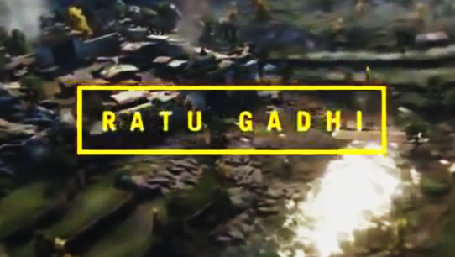
This is the piece of text in which I got my inspiration from.

Slide 2
A L W A Y S T O M O R R O W
This is what I came up with.

